Slide 1

IskolE — The School Management System
CS Group 38
Supervisors: Mr. Viraj Welgama & Mr. Janitha Dissanayake
Team: Seniru D S Senaweera, R K K Jinendra, R.S.R.G.A.A. Ananda, S.K. Thasindu Ramsitha
A production-ready, role-aware web application that centralises academic, administrative, and communication workflows for Sri Lankan schools.

Slide 2


Project Scope & Introduction
IskolE is a web-based School Management System (SMS) targeted at Sri Lankan schools. It centralises academic records, administrative tasks, and communications into a single platform with role-based access for five roles: Administrator, Management Panel, Teacher, Parent, and Student.
Why it matters
Core capabilities
Current workflows rely on paper logs, spreadsheets, and verbal notices — causing data errors, delayed reporting, poor transparency, and fragmented communication. IskolE replaces these with automated, auditable digital processes.
Automates timetables, attendance, marks, announcements, and learning materials while enforcing RBAC and secure access.

Slide 3


Functional & Non-Functional Requirements
Admin (Functional)
Full CRUD for management staff, teachers, students, parents; grade/class/subject management; assign class teachers.
Management Panel (Functional)
Manage records, broadcast announcements, timetables & exam schedules, approve/reject teacher leave.
Teacher (Functional)
Take attendance, enter/update marks, upload learning materials, post announcements, submit leave, add behaviour remarks.
Student & Parent (Functional)
Students view marks, timetables, attendance, progress; Parents view child’s marks, attendance, behaviour, teachers, and submit pre-absence requests.
Non-functional highlights: Security (password hashing, RBAC), Reliability (HA, transactional integrity, backups), Performance (page load < 2s), Usability (intuitive UI), Maintainability (MVC, documented code, CI), Portability (LAMP + Docker).

Slide 4

System Analysis & Design
Architecture centered on a USER entity with specialisations for Student, Teacher, and Parent. Use cases for five actors (Administrator, Management Panel, Teacher, Student, Parent) map directly to role-scoped dashboards and workflows.
ER Model
Class Diagram
Activity Flows
USER core with polymorphic links to Student, Teacher, Parent; Class, Subject, Timetable, Attendance, Marks entities with referential integrity.
MVC-aligned controllers (AuthController, AttendanceController), models (UserModel, MarkModel) and entity/value objects ensuring separation of concerns.
Role-specific flows (Login → Dashboard → Role actions). Admin and Manager flows include publish/unpublish controls and approval steps.
Key improvements: digital CRUD replacing paper logs, automated rank/average calculations, centralised timetabling with publish controls, and role-scoped dashboards replacing fragmented communication channels.

Slide 5
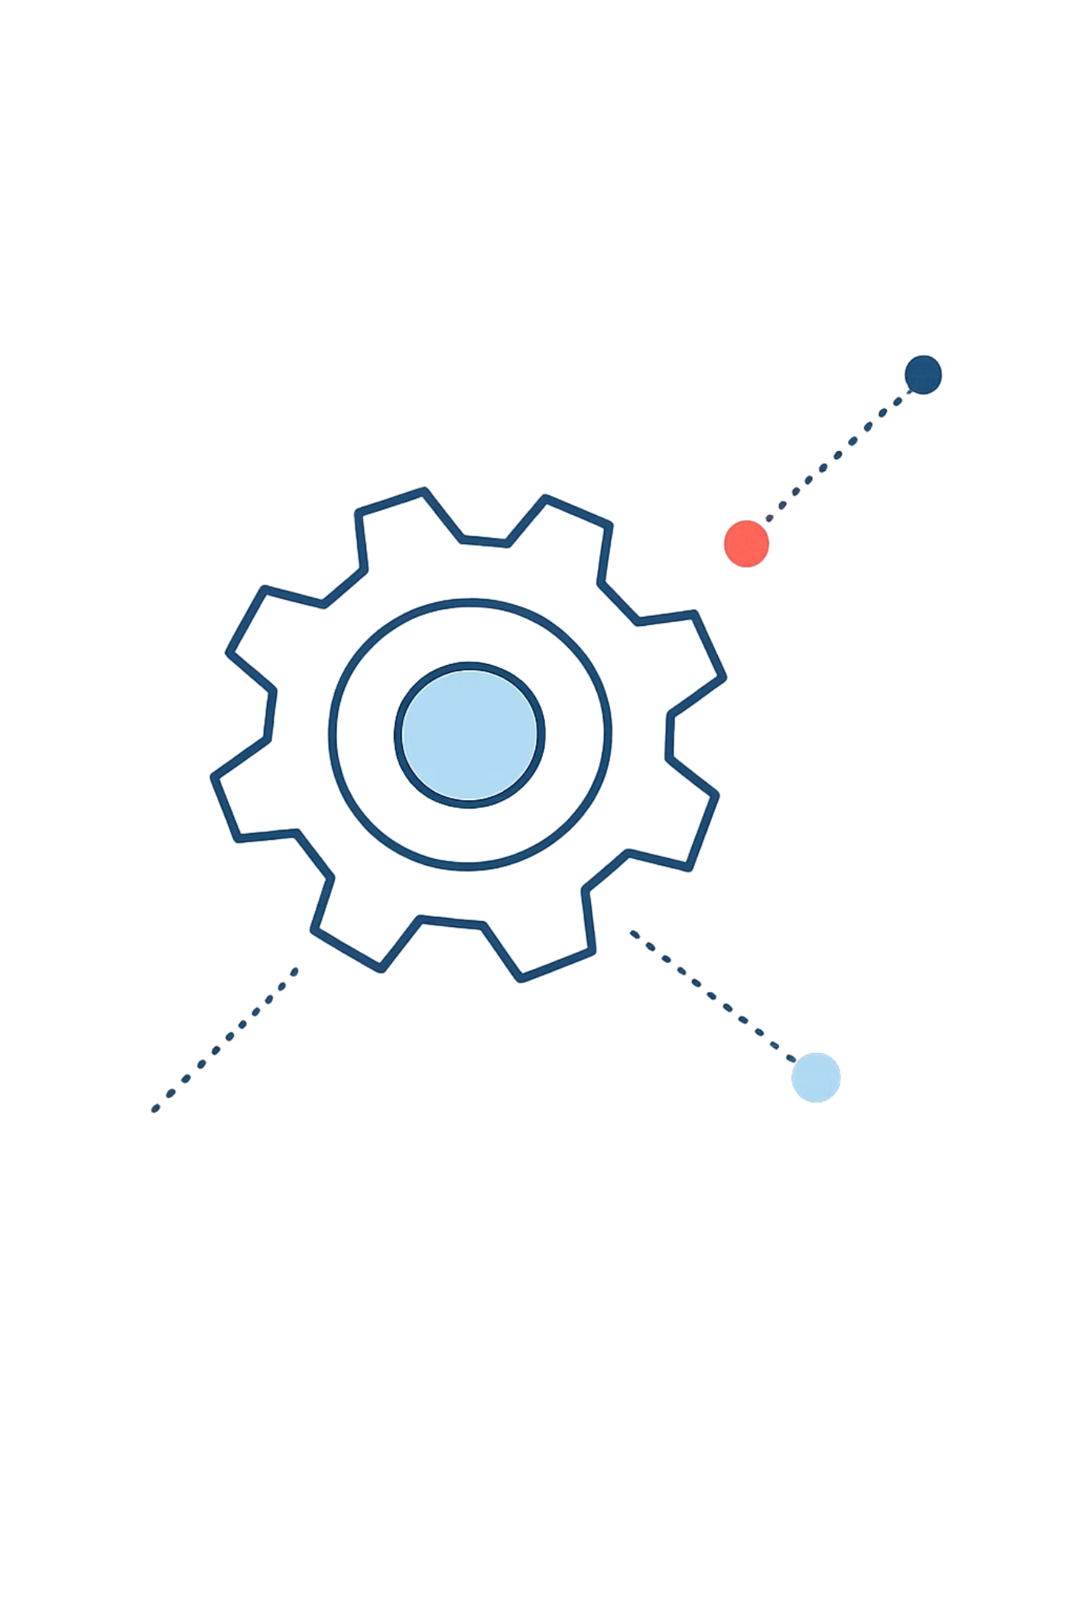
System Architecture & Tech Stack
Model
View
Data access, business rules: DB interactions, averages, rankings, attendance computations.
HTML/CSS/JS presentation; forms and dashboards without business logic.
Controller
Request handling, input validation, navigation, orchestrating model & view interactions.
Tech stack: Frontend — HTML, CSS, JavaScript; Backend — PHP; Database — MySQL; Containerisation — Docker; Version control — Git/GitHub; Project management — Jira.
Key modules: Authentication, Student & Teacher Management, Attendance, Marks & Performance, Announcements, Learning Materials, Timetable & Calendar, Behaviour & Remarks, Admin (Grades/Classes/Subjects).

Slide 6



Usability & User Experience
Role-specific Dashboards
Intuitive Navigation
Future-ready UX
Each role sees only relevant data and actions — reduces cognitive load and prevents unauthorized access.
Consistent UI patterns, clear affordances, and a central announcement feed keep users oriented and informed.
Fingerprint attendance simulation and quick analytics (auto ranks, averages, attendance %) provide fast insights without manual calculations.
Onboarding: phone number as default password for initial access. Real-time timetable publish/unpublish ensures users always see the intended schedule.

Slide 7

Testing Strategy & Results
1
Coverage
Test documentation maintained in Google Sheets covering all 19 modules; test cases map directly to requirements.
2
Test Types
Unit testing (business logic functions)
Functional testing (end-to-end module validation)
CRUD operation testing across all modules
Integration testing (module interactions)
RBAC testing (5 roles verified)
3
Outcome
19 modules tested — all CRUD and role scenarios validated. Status: All test cases passed ✅

Slide 8
System Completeness & Team Contributions
Project status: 100% complete — all planned functionalities implemented across 16 CRUD-based modules with zero incomplete items.
Member
Modules / Responsibilities
R K K Jinendra
Management Staff, Teacher, Student, Parent Records; Absence Reasons
Seniru D S Senaweera
Announcements, Learning Materials, Teacher & Student Attendance
S.K. Thasindu Ramsitha
Marks/Results, Student & Teacher Timetables, Relief/Substitution
R.S.R.G.A.A. Ananda
Classes, Exam Timetables, Teacher Leave, Behaviour/Remarks, Subjects
Equal contribution across design, database, frontend, backend, testing, and integration — 25% each.

Slide 9

Technical Exposure & Theoretical Learning
Practical Skills
PHP server-side logic, session management, secure DB access (PDO/MySQLi), Dockerised deployments, Git-based collaboration, and Jira-driven project management.
Database & Architecture
Relational design, normalization, transactional integrity, ER modelling, and applying the MVC pattern in a production-like application.
Security & DevOps
RBAC design, password hashing, session timeouts, and containerised CI/CD-ready workflows for reproducible environments.
The project reinforced software engineering lifecycle practices: requirements → design → implement → test → deploy, and provided hands-on experience in production-ready system delivery.

Slide 10

Special Attributes & Conclusion
1
2
3
Production-ready Deployment
Innovative Features
Operational Strength
Live single-school deployment.
auto-calculated academic analytics, publish/unpublish timetable controls, and relief/substitution workflows.
Fully containerised (Docker) for portability and reproducibility; complete test coverage across all modules with passing results.
4
Teamwork & Outcome
Zero incomplete modules; equal 25% contribution per member; delivered a polished, role-aware platform that replaces fragmented manual processes.
Conclusion: IskolE successfully modernises school administration by providing a secure, reliable, and usable platform for administrators, teachers, parents, and students — fulfilling project goals and academic evaluation criteria.

